Slide 1
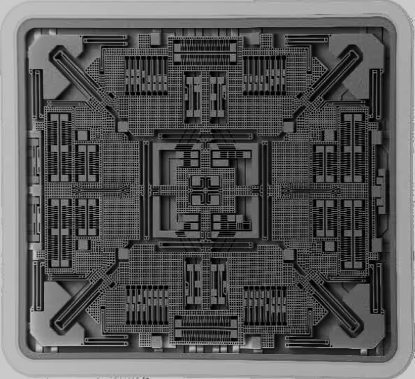
MEMS:
ELECTRONIC CIRCUIT ANALYSIS - ACTIVITY
Microelectromechanical Systems
ECE - A
Done by: 22wh1a0406, 22wh1a0409, 22wh1a0416, 22wh1a0421

Slide 2
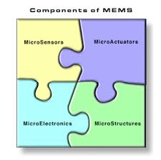
INTRODUCTION
What is MEMS?
Microelectromechanical Systems (MEMS) are miniaturized mechanical and electro-mechanical devices created using microfabrication techniques. They integrate mechanical components, sensors, actuators, and electronics on a silicon substrate. MEMS devices range from simple structures to complex systems with multiple moving parts and circuits.
Importance of MEMS
MEMS technology is essential in automotive systems, medical devices, consumer electronics, and telecommunications. It offers highly reliable, small-scale, and cost-effective solutions. This technology enhances the performance and miniaturization of multivibrators, crucial circuits for timing, pulse generation, and waveform shaping in electronic systems.

Slide 3
ADVANTAGES AND APPLICATIONS:
MEMS (Micro-Electro-Mechanical Systems) are used because they offer:
Miniaturization: They are very small, allowing integration into compact devices.
Low Power Consumption: They operate efficiently with minimal power.
High Precision: They provide accurate sensing and actuation.
Cost-Effectiveness: They can be mass-produced at low cost.
Versatility: They are used in various applications like sensors, actuators, and RF devices.
MEMS (Micro-Electro-Mechanical Systems) are used in:
Consumer Electronics: They make smartphones and game controllers more responsive by sensing motion.
Automotive: They help in cars by monitoring tire pressure and triggering airbags for safety.
Healthcare: They deliver drugs precisely and provide portable diagnostic tools for diseases.
Aerospace: They guide satellites and airplanes accurately using tiny gyroscopes and accelerometers.
Telecommunications: They improve wireless devices by making switches and filters that work faster and more efficiently.

Slide 4
MULTIVIBRATORS
Astable Multivibrator
Function: Continuously switches between high and low states without external triggering.
Operation: Uses capacitors and resistors in a feedback loop to create an oscillating square wave output.
Application: Timing applications such as clock generators, PWM circuits, and tone generators.
Monostable Multivibrator
Function: Produces a single output pulse in response to an external trigger.
Operation: Has one stable state and returns to it after a specified time period.
Application: Used in timing and delay circuits, pulse stretching, and signal conditioning.
Bistable Multivibrator (Flip-Flop)
Function: Has two stable states, switching between them with an external trigger.
Operation: Toggles between states using triggers or clock pulses, storing binary data.
Application: Used in memory storage, digital logic circuits, counters, and sequential logic.

Slide 5

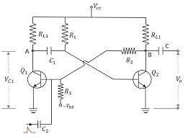
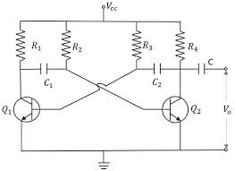
MULTIVIBRATORS:
BISTABLE MULTIVIBRATOR
MONOSTABLE MULTIVIBRATOR
ASTABLE MULTIVIBRATOR

Slide 6
Advancements in MEMS Technology for Multivibrators
Miniaturization and Integration
  Microscale Fabrication
  Monolithic Integration
Enhanced Precision and Stability
  High-Precision Manufacturing
  Temperature Compensation
Low Power Consumption
  Energy-Efficient Design
  Low Voltage Operation
High Performance
  High Q-Factor Resonators
  Reduced Parasitic Effects
Advanced Materials and Fabrication Techniques
  Novel Materials
  3D Printing and Additive Manufacturing
Multi-Functionality
  Sensor Integration
  Adaptive Control
Cost-Effective Production
  Batch Fabrication
  Scalable Manufacturing

Slide 7
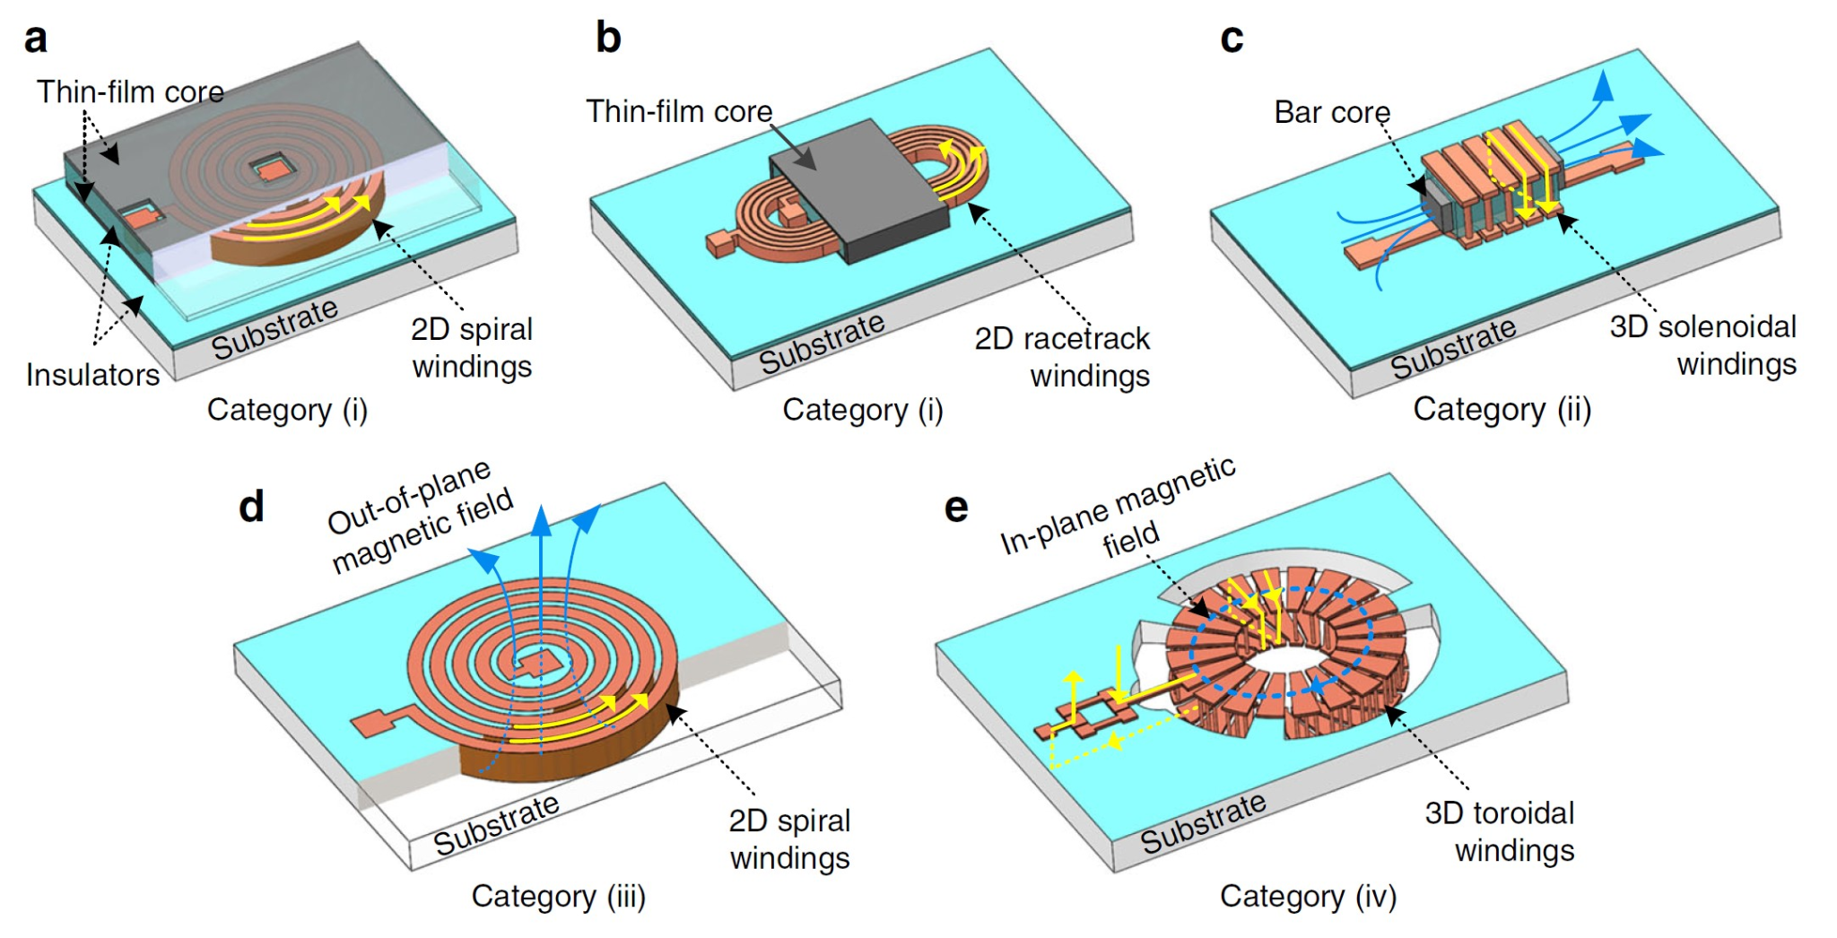
Oscillators and Timers: MEMS technology can be used to create precise, stable, and low-power oscillators and timers.
Signal Generators: MEMS-based multivibrators can generate high-frequency signals with high precision, useful in communication systems.
Switching Circuits: MEMS technology enables the creation of fast, reliable switching circuits used in digital and analog applications.
In summary, MEMS technology offers substantial advancements in miniaturization, precision, stability, power consumption, and cost-effectiveness, all of which can significantly enhance the performance and capabilities of multivibrators.
APPLICATIONS IN MULTIVIBRATORS

Slide 8
Thank you!

